Slide 1
Smart Home Using Packet Tracer
Group Member
Md. Sohel Rana (ID- 011151284)
Safi ul Sahid (ID- 011151289)
Razia Sultana (ID- 011152158)

Slide 2
Introduction
Smart home is a house that uses currently released IOT technology to automate different activities of home. IOE devices connected to the internet, to allow the distant monitoring and controlling of different home appliances

Slide 3
Objective
Provide comfort, security, energy efficiency and convenience at all times.
We can control anything anywhere.
Improve security
Save energy
Enhance the entertainment experience
Functionality and flexibility is given to home appliances
Provide smart home at low cost

Slide 4
IOT Components we used:
Light
Ceiling Fan
Water Sensor
Lawn Sprinkler
Fire Sprinkler
Smoke Detector
Carbon Dixoide Detector
And So on

Slide 5
Features
Network interconnected
Completely Automated
Increase Comfort Level
Control of Iot devices
- Light, Fan, Ac, Webcam, Door, Temperature, Smoke,Carbon-di-Oxide etc.

Slide 6
Advantage
Fast , high efficiency
Great practical and good scalability
One message is required to control system

Slide 7
Disadvantage
Technology takes control of life
It is expensive

Slide 8
Project Implementation

Slide 9
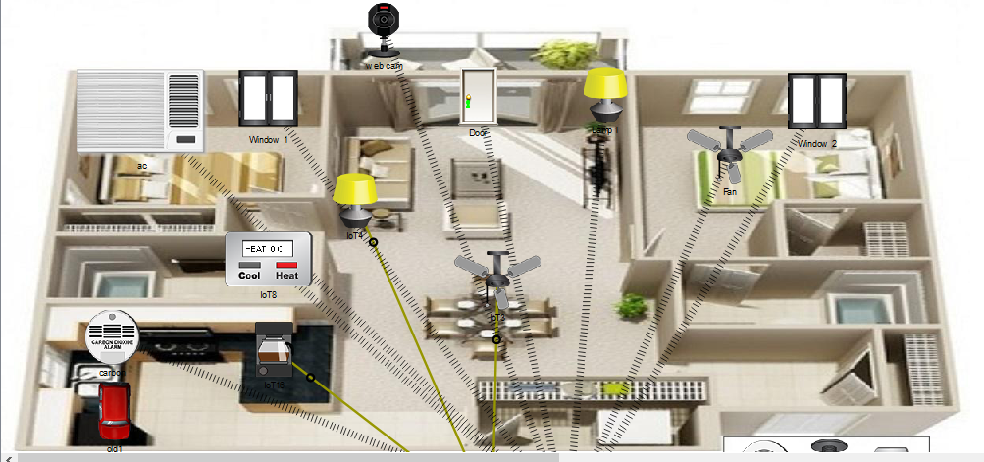

Slide 10
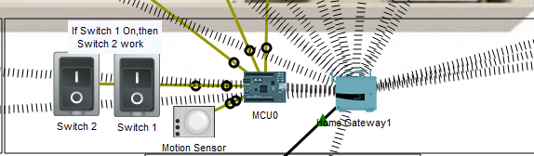
Home Gateway & MCU

Slide 11
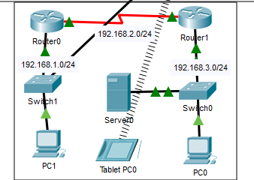
Access through Any PC

Slide 12
Future Expectation
Increased Efficiency, Control and Customization
Increased voice Control Integration
Focus on Security and Privacy Crisis.

Slide 13
Conclusion
It is evident that Smart Home opens a wide array of possibilities to enhance the quality of life in all aspects. But it is essential that we tap on the right spots to make this technology work the best for us.

Slide 14
“There is nothing like staying at home for real comfort.”
-Jane Austen

Slide 15
Thank You

